Slide 1
Game Structure
Introduction to Game Design and Development
ITCS 4230/5230
Dr. Dewan Tanvir Ahmed
Department of Computer Science
University of North Carolina at Charlotte

Slide 2
Outline
Pattern and Fun
Game Structure
Game Components

Slide 3
Fun and Patterns
Brain is a good tool for pattern recognition
We constantly make and use patterns
Language and faces are example of hardwired patterns
Abstract models with less details
Brain is hiding the real world!
Noise is a pattern we don’t understand

Slide 4
Fun as Learning
Games are simplified models that allow our brain to grasp a pattern and learn it quickly.
Fun is about brain feeling good!
Similar chemicals are released in seemingly different cases: music, chocolate, etc. !
Fun in games comes from mastery

Slide 5
Games that are not Fun…
Too easy
Not interesting
Too hard
Repetitive
Too fast

Slide 6
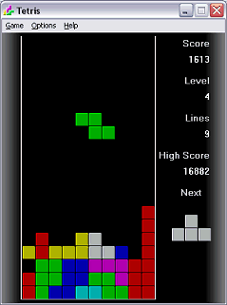
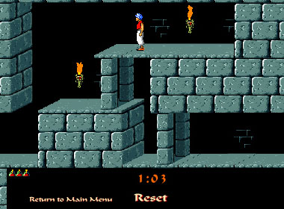
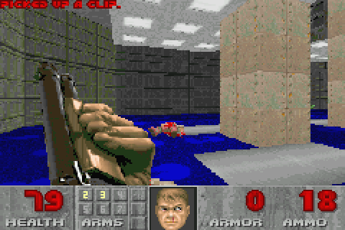
What We Learn from Games
As models of reality, games teach us about reality.
Power and status
How to examine environment
Relationships
Spatial reasoning
Possibilities and probabilities
Timing
Territory

Slide 7
Obsolete Skills?
Some skills we learn from games may not be necessary anymore or even wrong
Blind obedience
Rigid hierarchies
Binary thinking
Use of force
“like seeking like” and xenophobia

Slide 8

Discussion: Violence
Deathrace
Loosely based on the movie Deathrace
The first game to be taken off the market due to violence
Is it “just a game”?

Slide 9
Fun Is Contextual
People learn
different things, in different ways and at different levels
Games are unlikely to appeal to everyone.
More in Audience [part of the course]
How about those who want to cheat?
Aimbot (auto-aim)
Wallhack
ESP

Slide 10
Target Audience
Who will buy the game?
Design a game for a class of people, not for one person
Misconception: All players enjoy the same things that the designer enjoys.
The representative player is a member of your target audience
Notes:
Player-centric game design focuses on the representative player.

Slide 11
Target Audience
Who will enjoy your game?
What kind of challenges do they like?
What challenges would be good for Boys or Girls?

Slide 12
Binary Thinking
Binary thinking—assumes that if group A likes a thing, everyone outside that group WON’T like it.
Unsound reasoning
It would be foolish to ignore minority audience
If you ignore significant minority, you are throwing money
Interests overlap among groups

Slide 13
Binary Thinking
Hodgepodge of game features
Too many features and no harmony
Kung Fu + Chess + Monopoly!!!
Avoid exclusionary material
Avoid blood and gore for kids
Offended contents
Women - sensitive to aesthetics of a game
Some people have no interest in narrative material

Slide 14
Binary Thinking
Core versus casual—the most significant method of grouping players
Hardcore gamers:
More than entertainment
A hobby
Tolerate frustration
Thrive on competition
Don’t like easy games
Casual gamers:
Play for sheer enjoyment
If frustrated, they stop playing
Must be entertaining whether it’s competitive or not
To build game for them – give a sense of rapid progress and achievement

Slide 15
Binary Thinking
Groups that exhibit trends in game-playing preferences:
Children and adults
Different motor and cognitive skills
Different attention and linguistic abilities
Men and women
Boys and girls
Players with disabilities
Players of other cultures
Boys’ and girls’ interests differ more widely than men’s and women’s do

Slide 16
Outline
Pattern and Fun
Game Structure
Game Components

Slide 17
Game Structures
Two different ways of presenting the player with a challenge
Emergence
A number of simple rules combining to form interesting variation
Progression
Separate challenges presented serially

Slide 18
Game Structures (cont.)
Emergence
Emergence is the primordial game structure, where a game is specified as a small number of rules that combine and yield large numbers of game variations.
Example:
Card and board games
Most action, and all strategy games.
Characteristics
tend to be replayable and
tend to foster tournaments and strategy guides

Slide 19
Game Structures (cont.)
Progression
Historically newer form - the adventure games
A predefined set of actions in order to complete the game.
One feature - strong control to the game designer:
Since the designer controls the sequence of events, where we find the games with cinematic or storytelling ambitions
Progression games have walkthroughs
all the actions needed to complete the game
Which one is Less interesting emergence or progression?
Progression

Slide 20
Example
Pong vs. Prince of Persia
Pong is simpler but it is
Unique every time
Open-ended
Requires strategy (even simple)
Easy to learn yet difficult to master
If the game guide is a walk-through, the game is progression type!

Slide 21
Example
Poppit
Hearts, Poker, Blackjack, Bridges, Tetris

Slide 22
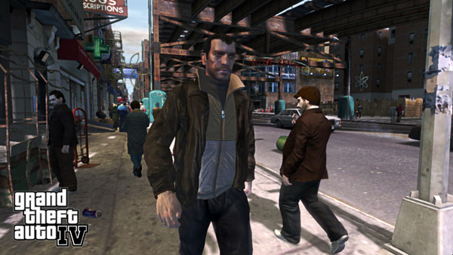
In-between Games
Many new games have both properties to some level.
Grand Theft Auto
Missions as progression
Ability to go around the city and complete the missions in different ways.
Story and freedom

Slide 23
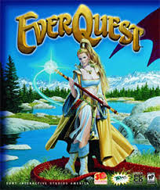
In-between Games
EverQuest
In most general levels, EverQuest is a game of emergence.
The actual events in the game are not explicitly determined by the game rules, but they will follow certain patterns.
At the same time it has a progression structure
since the game in detail describes the actions that the player has to perform.
Notes:
A large world is governed by a typical Dungeons & Dragons system where each character belongs to a certain class, has a number of statistics (such as strength, agility, wisdom, charisma, hit points, manna), a level, skills, and possessions.
Killing a sufficiently strong monster increases the player skills, adds hit points, and eventually lets the player progress to the next level, thereby allowing the player to kill even bigger monsters.
As such, the actual events in the game are not explicitly determined by the game rules, but they will follow certain patterns.
At the same time EverQuest contains a large number of quests, where a computer-controlled character (non-player character, NPC) through a simple conversation system presents the player with a task to complete, such as bringing a specific object to some other NPC, killing a monster, etc.

Slide 24
Gameplay: Challenge
A challenge is any task set for the player that is non-trivial to accomplish
Can be composed of several smaller challenges
Example:
Getting a ball through a hoop
Make business profit
Overcoming nontrivial challenges require mental or physical effort
Notes:
A challenge
Getting a ball through a hoop
Make business profit
Any video game:
Defeat a number of identical enemies, and then must overcome a unique challenge to defeat a particular boo enemy.

Slide 25
Gameplay: Rules in Action
The rules determine what actions are available to the player(s)
A video game will not respond to player actions that it has not been programmed to recognize.
Different actions may be
Permitted by the rules, or
Required by the rules, or
Prohibited by the rules
Optional actions:
Grand Theft Auto – you can listen to the radio in the car

Slide 26
Gameplay
Gameplay therefore consists of:
The challenges that a player must face to arrive at the object of the game, and
The actions that the player is permitted to take to address those challenges

Slide 27
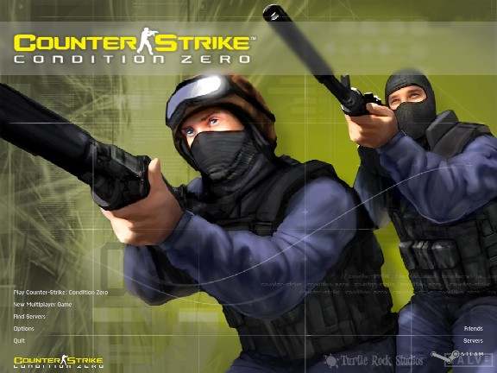
Example: Counter Strike

Slide 28
Gameplay example
Counter-Strike
Team-based shooter in which players can join
either the terrorist team, the counter-terrorist team, or become spectators
Unlike Quake or many other shooters
No re-spawn if you die!
Coordination
Strategy
Different outcomes
Small change in rules can result in big change in strategy and gameplay.
More on gameplay later!
Notes:
The objectives depend on the type of map like
Bomb Maps: The terrorists must carry a bomb, plant it on one of the designated spots and protect it from being disarmed by the counter-terrorists before it explodes to win. The counter-terrorists win if the time runs out with no conclusion.
Hostage Maps: The counter-terrorists must rescue a group of hostages held by the terrorists to win. The terrorists win if the time runs out with no conclusion.
VIP Maps: One of the counter-terrorists is chosen to act as a VIP and the team must escort this player to a designated spot on the map to win the game. The terrorists win if the VIP is killed or if the time runs out with no conclusion.
Source: wiki

Slide 29
Gameplay example
Braid and “reverse time”
The game is divided into six worlds, which are experienced sequentially and can be entered from different rooms of Tim's house;
The player's unlimited ability to reverse time and "rewind" actions, even after dying.
The player can return to any world previously visited to attempt to solve puzzles they missed.
Notes:
Braid is played by solving physical puzzles in a standard platform game environment. The player controls the protagonist Tim as he runs, jumps, and climbs across the game's levels. Tim jumps and stomps on enemies to defeat them, and can collect keys to unlock doors or operate levers to trigger platforms. A defining game element is the player's unlimited ability to reverse time and "rewind" actions, even after dying. The game is divided into six worlds, which are experienced sequentially and can be entered from different rooms of Tim's house; the player can return to any world previously visited to attempt to solve puzzles they missed.

Slide 30
Storytelling
Most games incorporate some kind of story
Video games can mix storylike and gamelike entertainment almost seamlessly
Advantages
make player feel he is inside a story and affecting flow of events
This is one reason why video games are considered a new medium

Slide 31
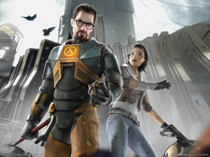
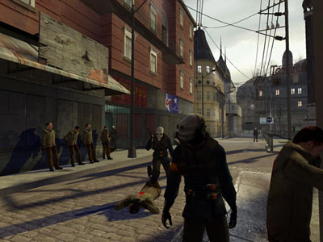
Example: Half-Life
Relatively well-developed characters and storyline
Can give players reason for performing actions
Can cause emotional attachment
So the experience will be more enjoyable.

Slide 32
Artificial Intelligence
Started in games as a way to create artificial opponents
Today, artificial intelligence is used for
Strategy
determining an optimal action to take
Creating and controlling NPC behavior
Pathfinding
Finding the most advantageous routes through a simulated landscape.
Notes:
Currently, the behavior simulations are very simple. The goal of AI research is to create ever more realistic simulations.

Slide 33
Artificial Intelligence
As artificial intelligence advances, games will add more uses for it
Natural language parsing
Natural language generation
Pattern recognition
Face, voice, behavior
Poker – establish a correlation between their opponent’s behavior and their cards
More later!

Slide 34
Fairness
Players expect
The rules will guarantee that the game is fair
Fairness is not an essential element but a quality of good games
Players may change rules of a game if they perceive it as unfair
Fairness is particularly important in video games because video games seldom allow rule changes
Multiplayer game
Equal chance of winning at the beginning of the game.
Notes:
All the players in multiplayer game must have an equal chance of winning at the beginning of the game.

Slide 35
Risks and Rewards
Risks and Rewards
A source of entertainment – e.g. gambling
A risk must always be accompanied by a reward, Otherwise the player has no incentive to take the risk

Slide 36
Risks and Rewards
War game
Risk: begin an attack, attack’s being detected and repulsed
Reward: controlling new territory, or depleting the enemy’s resources
Monopoly
Risk: purchase property
Reward: income from rents later on!

Slide 37
Risks and Rewards
Risk is created by uncertainty
Unknown consequences
Gambling – uncertainty is produced by chance
Dice fall
Enemy’s troops hiding?
Playing a game is intrinsically entertaining, but risks and rewards to a games makes it more exciting.
Why?
Raises the level of tension
Make success or failure more meaningful

Slide 38
Risks and Rewards
Punishment should be reasonable.
What is reasonable?
If the player overcomes the risk, a reward should be given
The size of the reward should match the size of the risk
Reward Types:
Advance the player’s interest
Tangible benefits:
Money or a key to a locked area
Intangible
A strategic advantage

Slide 39
Creative and Expressive Play
People love to create, design, and customize
To reflect their own choice
Clothing, creatures, building
This activity can have a direct effect on gameplay
As video games reach a wider audience, creative and expressive play become increasingly important

Slide 40
Socializing
Most traditional games are played with other people, making it a social activity
Most multiplayer games have a communication method built into the software.
Players often use communication software such as
TeamSpeak or Ventrilo.

Slide 41
Socializing (cont.)
Several methods allow people to play video games together
Multiplayer local
Two or more players playing together in one place
Networked play (multiplayer distributed)
Play games over the Internet
To communicate
Voice connection or type messages
LAN parties
Group play

Slide 42
Outline
Pattern and Fun
Game Structure
Game Components

Slide 43
Key Components
A game is composed of (In order to create gameplay and offer it to the player)
Core mechanics
User interface
Optional storytelling engine
These are conceptual not technical!
Game engine is the software module that implements core mechanics, plus other things such as rendering and networking

Slide 44
Core Mechanics
Definition: Turn the general rules into a symbolic and mathematical model which can be implemented algorithmically.
Core mechanics
More specific than rules
Example:
Rule: Caterpillars move faster than snails
Core mechanics state exactly how fast each move in centimeters per minute.
Think your first assignment – The solar system

Slide 45
Core Mechanics (cont.)
Core mechanics generate the gameplay
Define the challenges
Define the actions
Define the player’s effect on the game world
Core mechanics determine how realistic the game world seems to the player

Slide 46

Mechanics - A definition
A mechanic is any in-game device where the player can execute an action, an effect in the game takes place, and the player will get some feedback from their action.

Slide 47
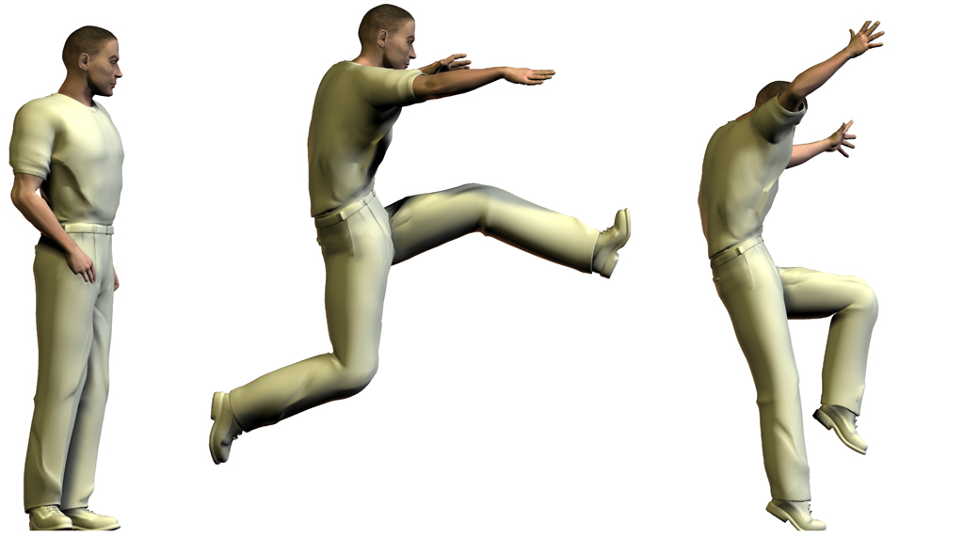
Mechanics
Standing Jump

Slide 48
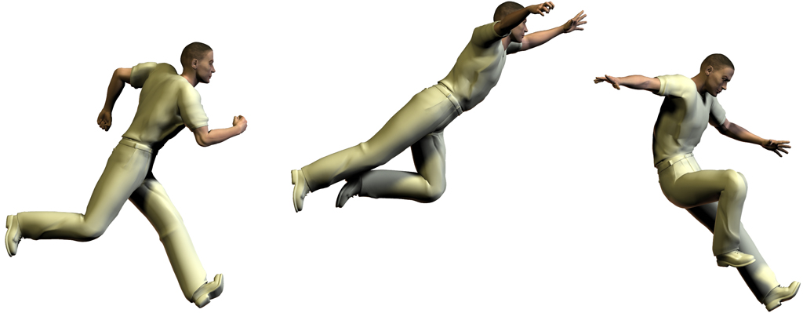
Mechanics
Running Jump

Slide 49
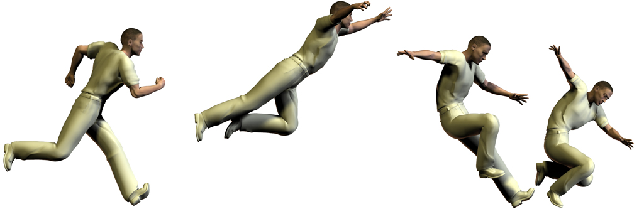
Mechanics
Added momentum!

Slide 50
Third person game mechanics
Up and behind view to give the player more information
Game mechanics can be more abstract to reflect the unique viewpoint
Opportunity for more sophisticated interaction with the environment
Replicating the ‘real world’

Slide 51
Racing game mechanics
Become more abstract as we are not controlling a ‘person’ but a machine
Game mechanics mimic real world affects like friction and inertia
May include more abstract mechanics like power ups and stunts

Slide 52
Real time strategy game mechanics
Abstract mechanics embody complex situations
Player challenged by imprecise information and control
Resource management and optimisation requirements provide variable game play

Slide 53
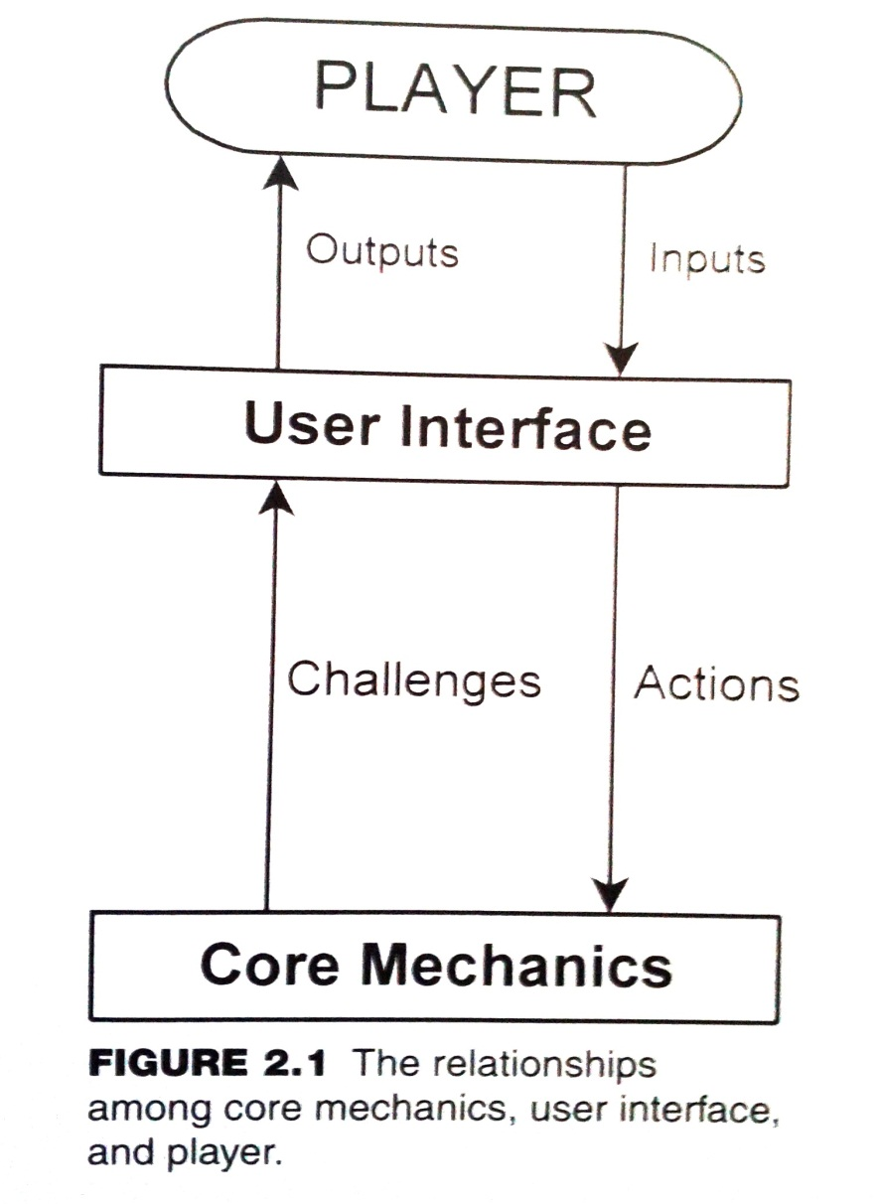
Game Components

Slide 54
User Interface
Mediates between the core mechanics and the player
Interprets player’s mouse clicks or button presses
Displays the result of the player’s input
Can also be called the presentation layer
Presents the game world to the player
Includes artwork and audio effects

Slide 55
User Interface (cont.)
Interaction model
The way in which the player acts upon the game world:
Avatar-based—through a character in the world
Multipresent—can act on many places at once
It defines what a player may and may not act upon at any given moment.

Slide 56
User Interface (cont.)
Perspective
Player’s point of view or camera angle
First person and third person are the most common perspectives
Notes:
Many games allow players to switch between first-person and third-person perspectives. In first person, the game world is shown as if you are the avatar. The avatar is not visible in first person because the player is looking through the avatar’s eyes. In third person, the avatar is followed by a chase camera that shows the avatar and the game world.

Slide 57
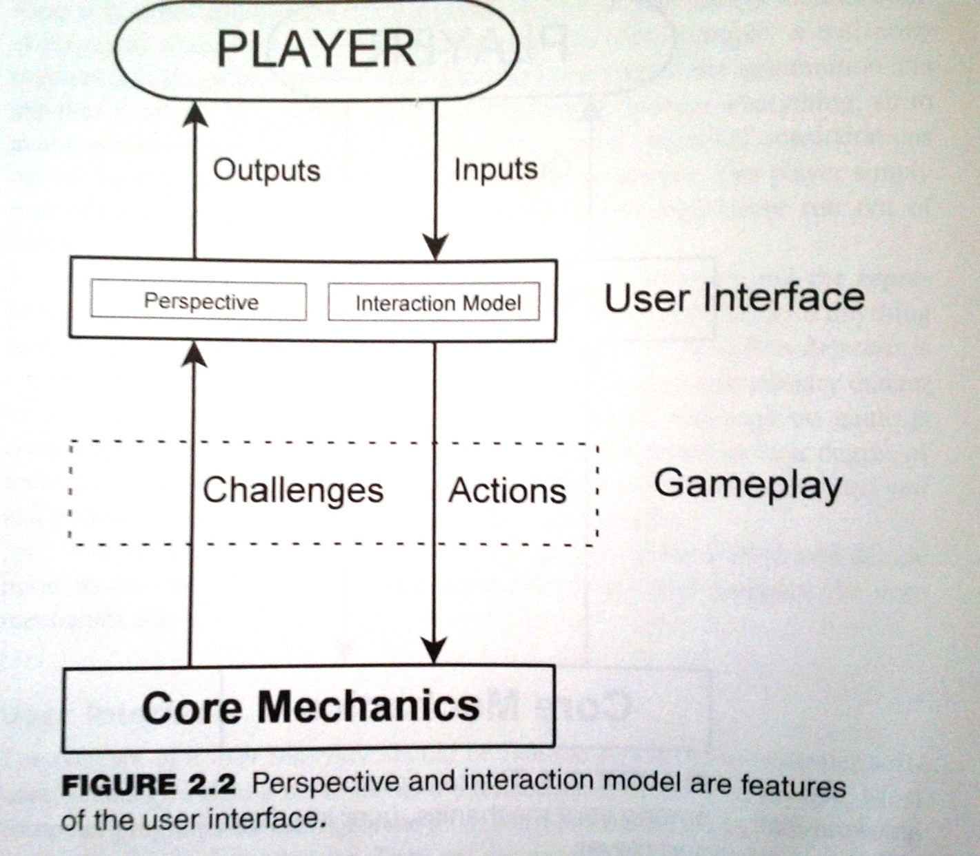
Game Components

Slide 58
Storytelling Engine
Adds NPC dialogs, cinematics (or cut scenes), and other story elements.
PC - Player Character
NPC - Non-Player Character
Not all games have story (and storytelling engine).
Storytelling engine is parallel to core mechanics, and interacts with it and UI.

Slide 59
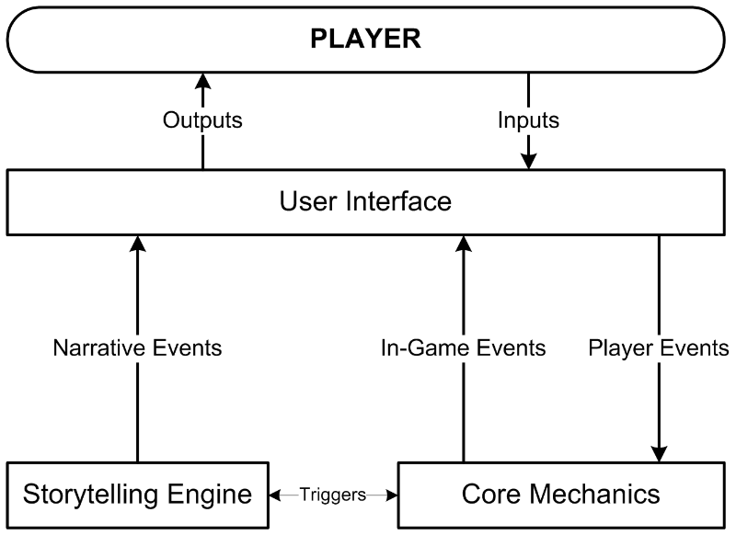
Story vs. Gameplay

Slide 60
Functional Structure
Functional structure is composed of
Gameplay modes
Shell menus
Notes:
A game seldom presents all its challenges at one time.
Most games present a subset of their complete gameplay, often with a particular interface.
Both gameplay and the user interface change time to time as the player is required to meet new challenges or to view the game world from a different perspective.
How and why the changes occur are determined by the game’s structure.

Slide 61
Gameplay Modes
Gameplay modes consist of the available gameplay and user interface at a specific time
Not all actions are available at all times
Available user interface choices should be related to the current actions
Only one gameplay mode is available at a time
Notes:
Use common sense to dictate which actions should be available at a particular time.

Slide 62
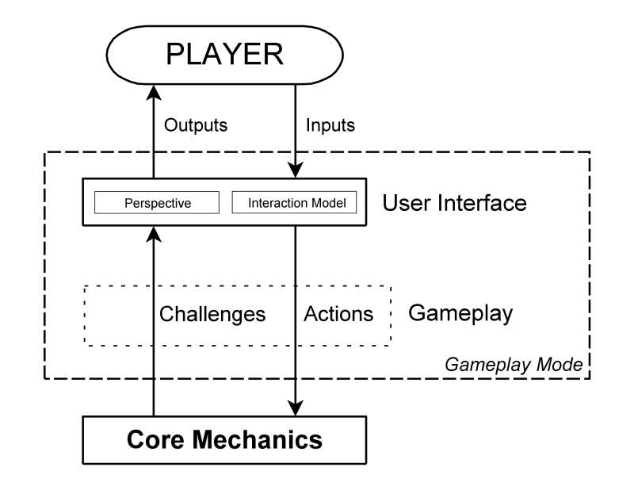
The Gameplay Mode

Slide 63
Shell Menus and Screens
Shell menus are used when the player is NOT in a gameplay mode
The player can’t affect the game world
The player can save or load a game, adjust the hardware, etc.

Slide 64
Forming the Structure
Gameplay modes + shell menus = structure
The game switches between gameplay modes as required:
In response to specific player requests
In response to events in the game

Slide 65
Reference
Some information and images are taken from the different online sources, only for educational purpose. I acknowledge them.

Slide 66
Thank you!

